Slide 1

Combining Hough Transform with Contour Tracing for Enhanced Image Processing
Course: Signal Processing System Design Laboratory
Name: Yash Anand
Roll No.: 23EE5R22

Slide 2
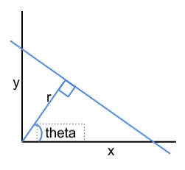
Hough Transform
Hough Space
Line representation: a line is identified by the couple (θ, ρ)
ρ = x*cos(θ) + y*sin(θ)
Objectives
→ Line detection
→ For each point P(xp, yp) which belongs to the contour/edge, calculate lines by varying theta (obtaining couples: (rho, theta))
→ Counting the number of occurrences (n) of a particular line (same rho
and theta) in the image, If n > threshold : line really exists in the image

Slide 3
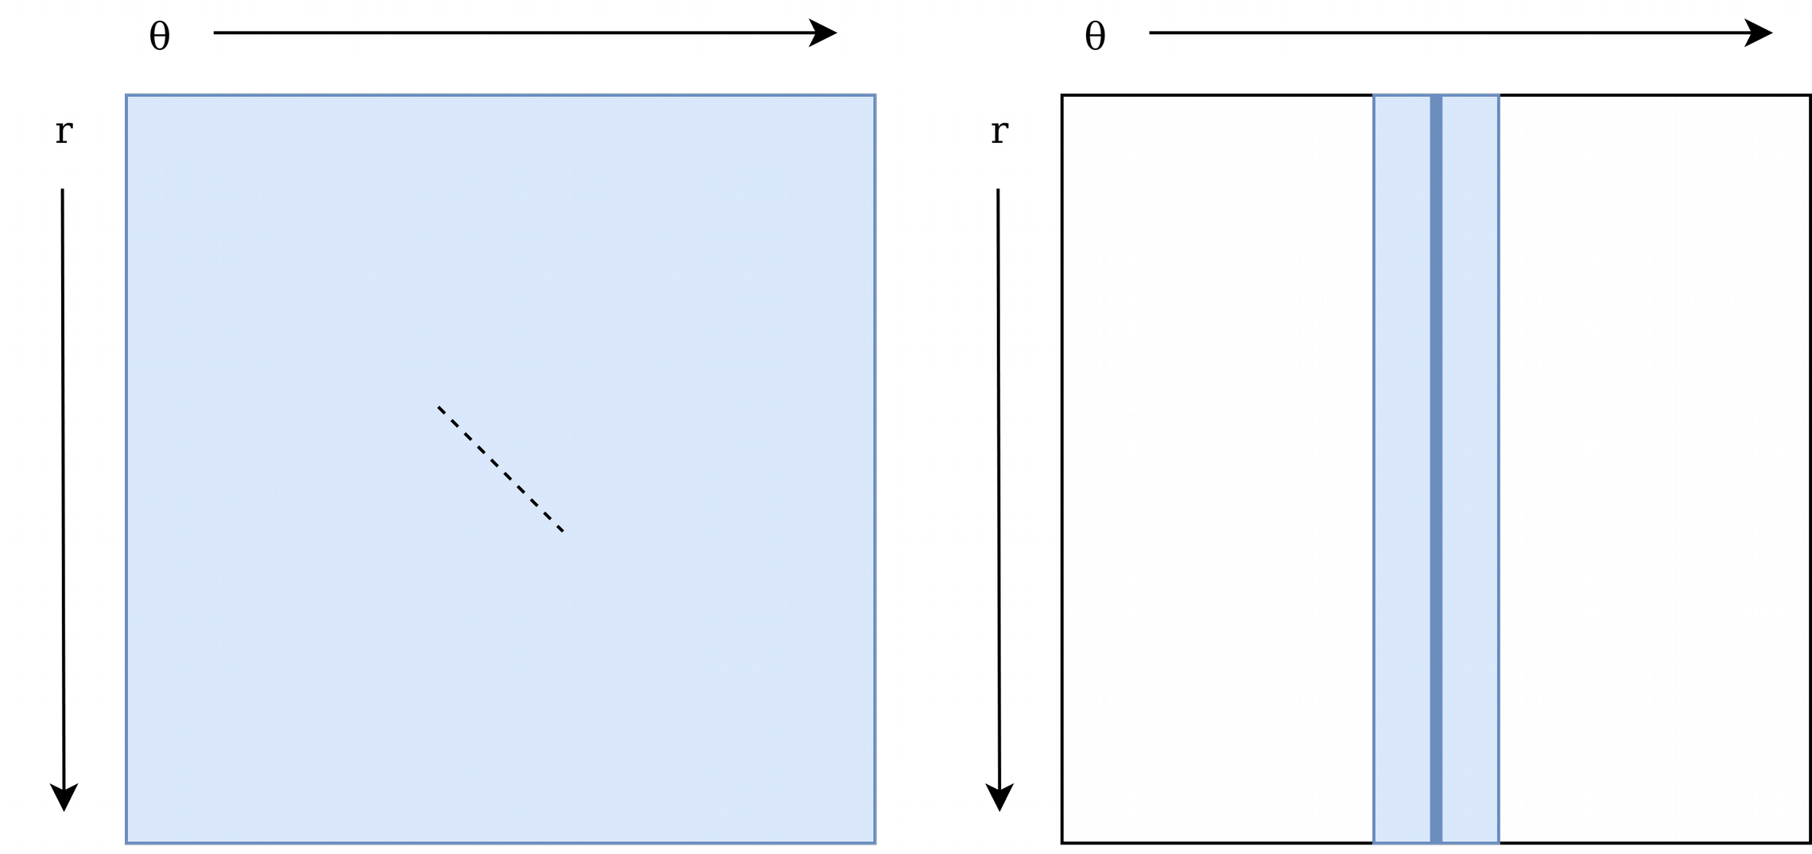
Problem
Basic Implementation: we need to consider all the possible lines – all the possible rho and theta values!
...and if we could try just a subset of all the possible lines?

Slide 4
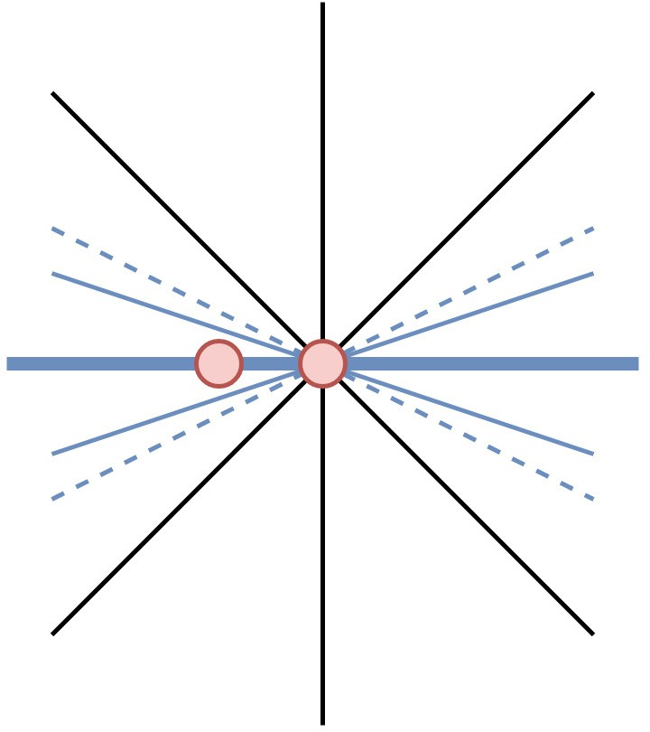
Solution
●
Starting from contour-detection algorithm, we can calculate just few lines
→ Main direction is discovered connecting the new contour pixel with the previous one
→ Lines we care about belong to the range: [main
direction – angle; main direction + angle]

Slide 5
Preprocessing
We start from a whatsoever color image Apply Canny edge detector
This is the starting point for the contour tracing algorithm
●
●
●

Slide 6
The algorithm – contour tracing
Algorithm:
Moore Neighbor
●
We need to introduce the concept of direction (north, south, east, west)

Slide 7
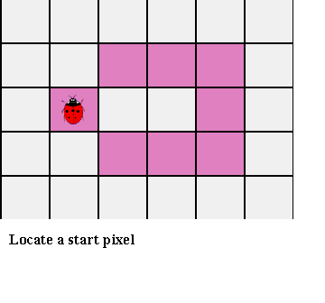
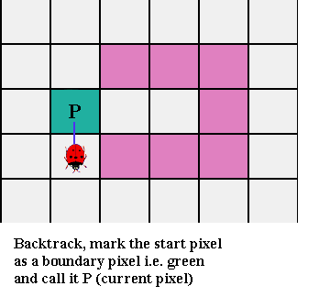
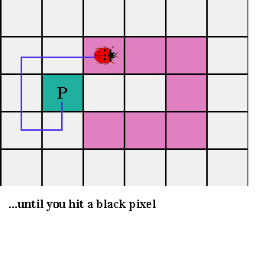
The algorithm – Moore Neighbor
Start from a pink pixel (S), Invert direction and go to the next pixel while (current pixel != S)
Invert direction and go to the next pixel
Visit S’ Moore neighbors, clockwise, until finding a pink pixel, adding it to contour pixels
(1) (2) (3)

Slide 8
The algorithm – Contour tracing
How to find more than one contour?
After finding each contour, we delete contour pixels in the edge map
Iterate until there’s no edge pixel left
●
●
●

Slide 9
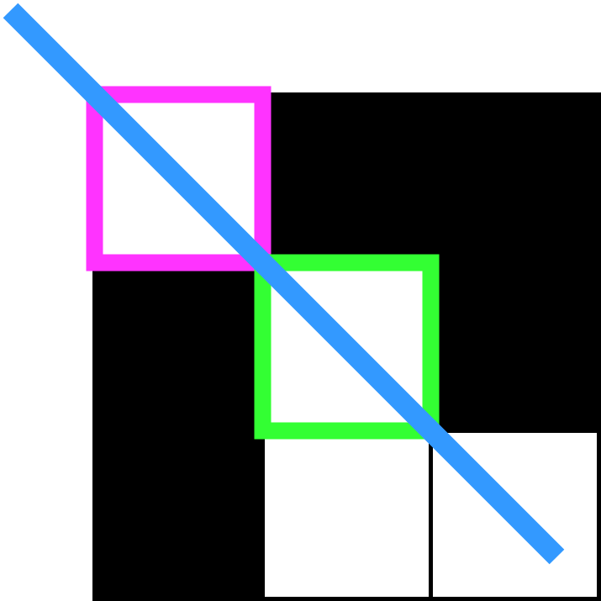
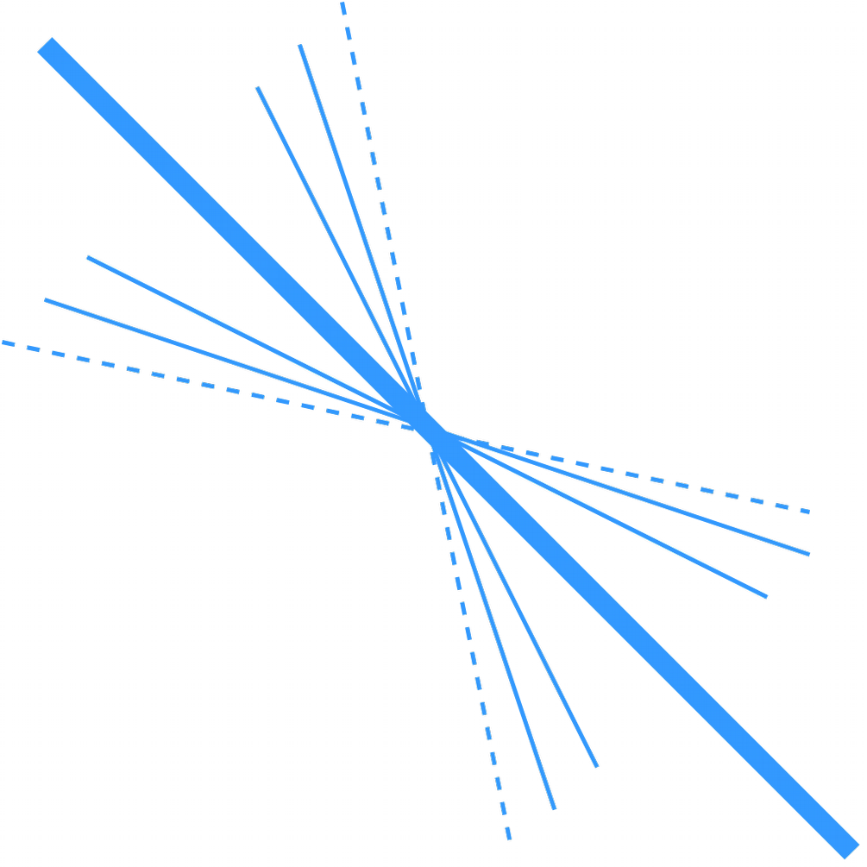
The algorithm – Finding lines
Main direction is calculated as:
Θ = arctan ( ∆y / ∆x )
∆y and ∆x with respect to current pixel and previous pixel detected
So, it is now possible to try just lines which belong to the blue interval!

Slide 10

Pseudo-code
edge_map = edge_detection(image)
while (not edge_map is empty): contour_detection_hough(edge_map) delete_last_contour(edge_map)
draw_lines()

Slide 11
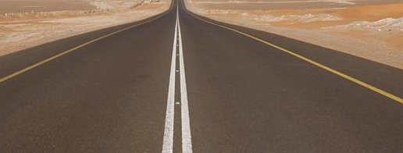
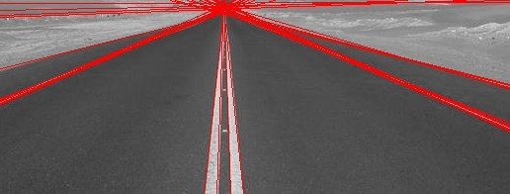
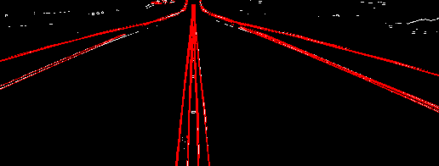
Performances
Basic algorithm
10.77 s
Our algorithm
10.62 s

Slide 12

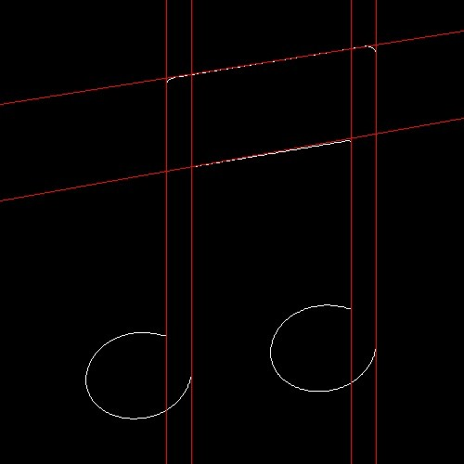

Performances
Basic algorithm
8.27 s
Our algorithm
3.09 s

Slide 13
Conclusions
It has been implemented an algorithm that avoids to generate all lines as done in Hough.
This approach could lead to a faster Hough and could be farther enhanced with the use of a better contour algorithm
However, performances should be also compared to more efficient method to do the Hough transform, such as the probabilistic one
●
●
●

Slide 14
References
[1] | W. Niblack, and D. Petkovic, "On Improving the Accuracy of the Hough Transform: Theory, Simulations, and Experiments", in IEEE Conference on Computer Vision and Pattern Recognition, 1988, pp. 574- 519
[2] | Tran Duc Duan, Duong Anh Duc and Tran Le Hong Du, "Combining Hough transform and contour algorithm for detecting vehicles' license-plates," Proceedings of 2004 International Symposium on Intelligent Multimedia, Video and Speech Processing, 2004., Hong Kong, China, 2004, pp. 747-750, doi: 10.1109/ISIMP.2004.1434172.

Slide 15
THANK YOU

